Slide 1
Teacher Resources
Student-facing video lecture of this slideshow
Notes handout
Student Resource: Infographics
Assessment

Slide 2
Evidence of Climate Change
Driving Question
How do we know climate change is happening?
Learning Target
I can analyze data about earth systems to make evidence-based predictions about current and future impacts due to climate change.

Slide 3
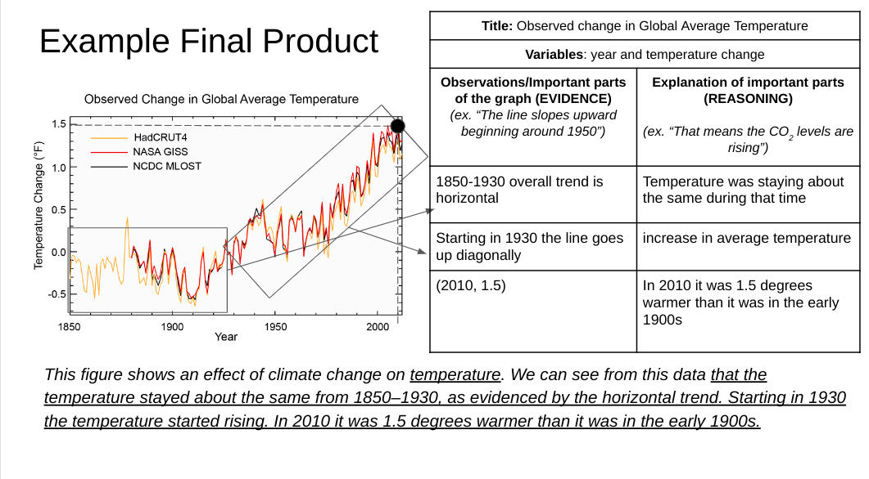
What will I do to show my learning after this lesson?
Select a graph or data visual of climate change effects that will be shared with the class.
Summarize and explain the meaning.

Slide 4
Infographics
What is a infographic?
Info = information
Graphic = Visual
An infographic is a visual way to show data to highlight patterns and draw attention to important information.

Slide 5
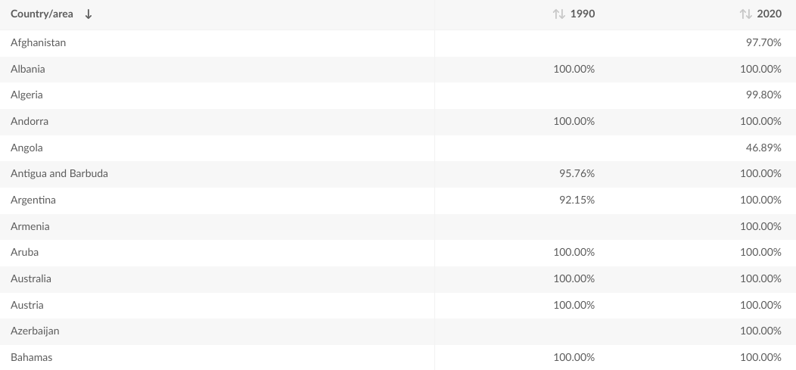
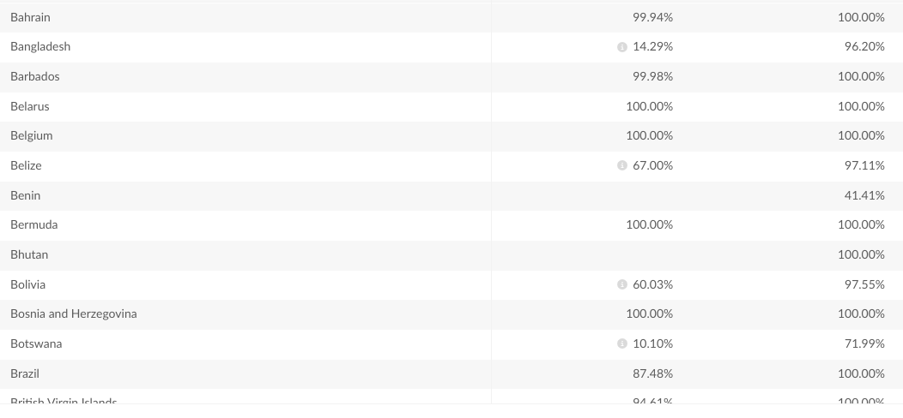
Infographics
Can you identify patterns in this data?

Slide 6
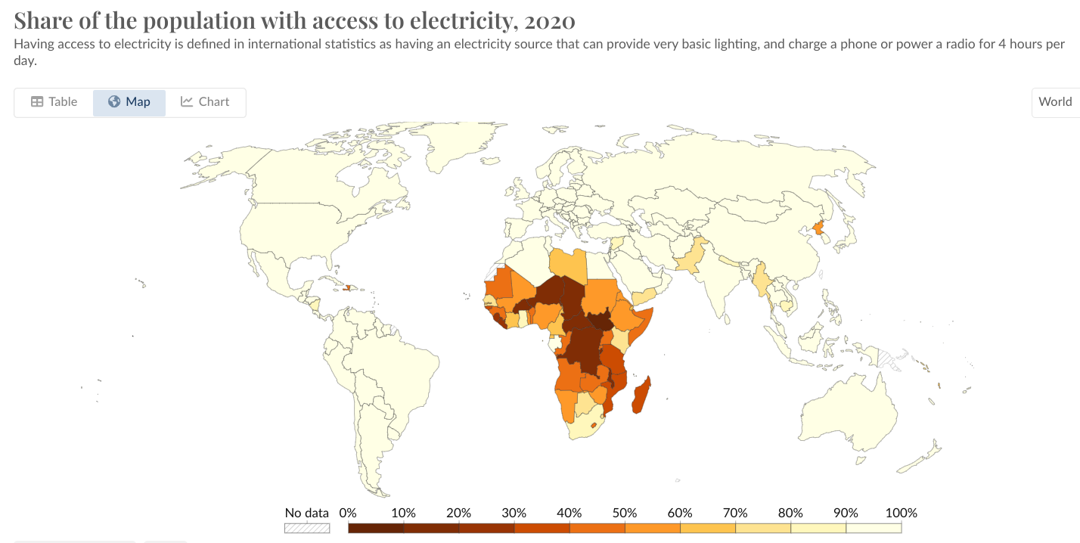
Infographics
How about this?
What story is this map telling us?

Slide 7
Infographics
Visual ways to show data to highlight patterns and draw attention to important information

Slide 8
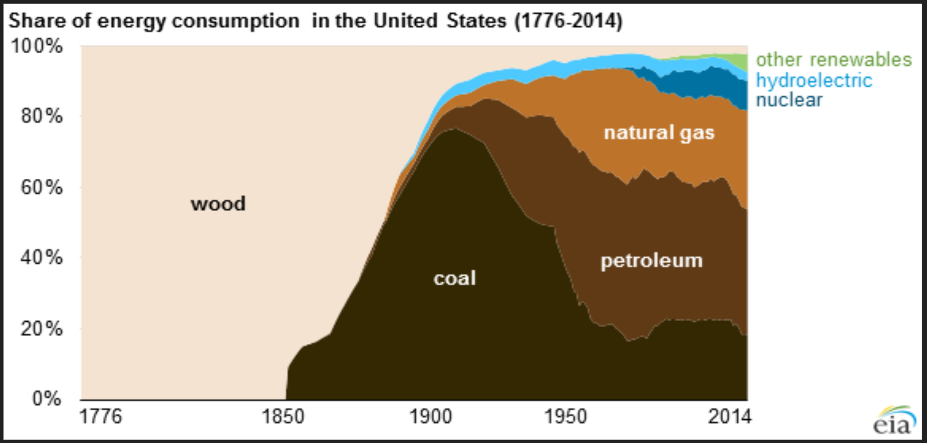
Infographics
Visual ways to show data to highlight patterns and draw attention to important information

Slide 9
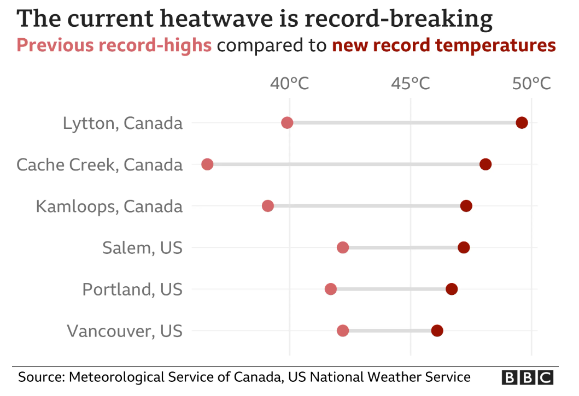
Infographics
Visual ways to show data to highlight patterns and draw attention to important information

Slide 10
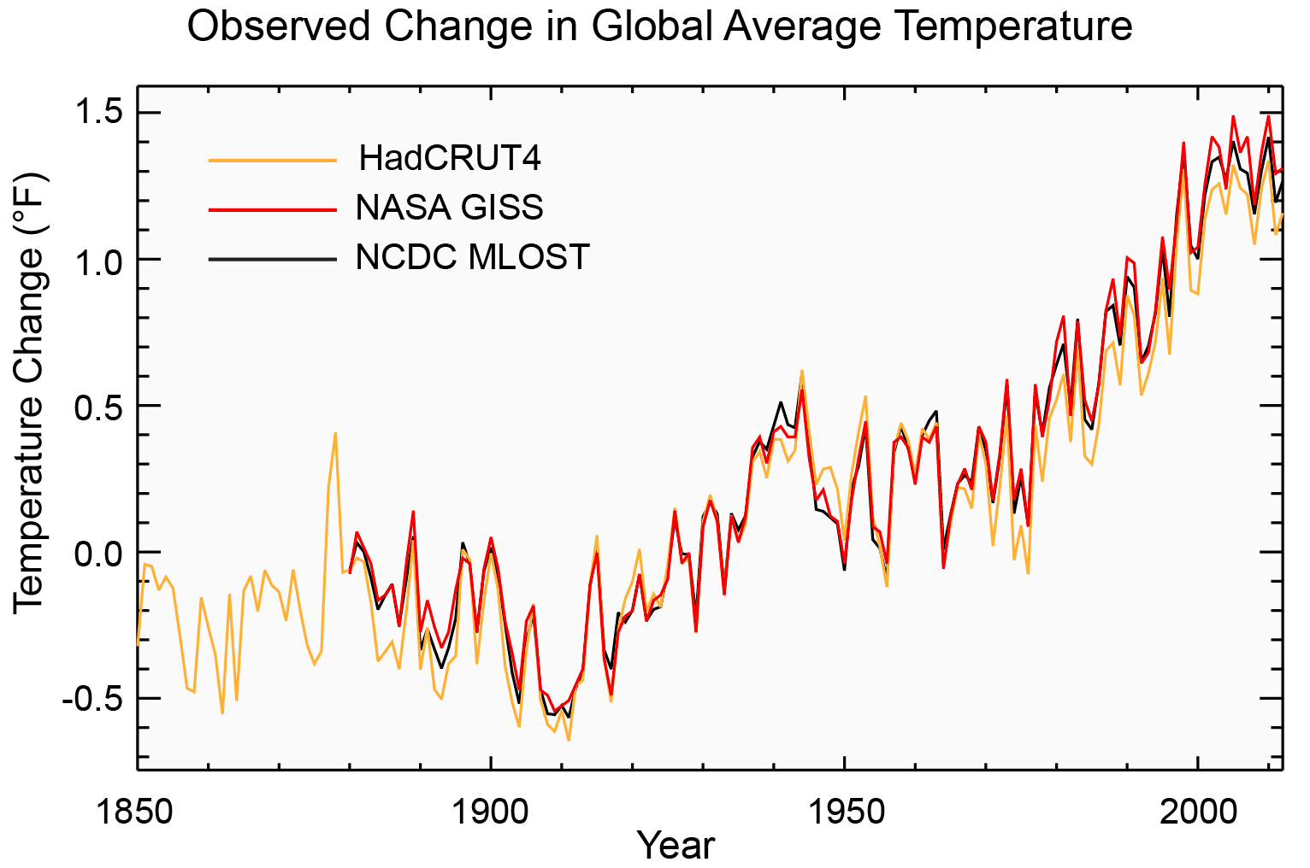
Infographics
Visual ways to show data to highlight patterns and draw attention to important information

Slide 11
Infographics
Visual ways to show data to highlight patterns and draw attention to important information

Slide 12
What do you need to do for mastery?
I can summarize the meaning presented in different types of graphs and visuals
Identify what variables are displayed
Interpret patterns
Point out small details
Annotate (draw/write on) the infographic to draw attention to the most important parts
Use the most important information and your annotations to write a three sentence summary that explains the main idea.

Slide 13
Example Data
Figure Title: Observed change in Global Average Temperature Variables: Year, Temperature
Observations/Important parts of the graph (EVIDENCE) (ex. “The line slopes upward beginning around 1950”) | Explanation of important parts (REASONING) (ex. “That means the CO₂ levels are rising”)
The y-axis is temperature change. In 2010 the line is at 1.5 on the y-axis (2010, 1.5) | The y-axis shows difference in temperature, so 0.0 means “no change.” In 2010 it was 1.5 degrees warmer than the average in the early 1900s
1850-1930 line goes up and down but the overall trend is horizontal | This means the temperature was staying about the same during that time
Starting in 1930 the line starts going up diagonally | This shows an increase in average temperature
Fig 1: Three different global surface temperature records all show increasing trends over the last century. The lines show annual differences in temperature relative to the 1901-1960 average.
This figure shows an effect of climate change on temperature. We can see from this data that the temperature stayed about the same from 1850–1930, as evidenced by the horizontal trend. Starting in 1930 the temperature started rising. In 2010 it was 1.5 degrees warmer than it was in the early 1900s.

Slide 14
Example Final Product
Title: Observed change in Global Average Temperature
Variables: year and temperature change
Observations/Important parts of the graph (EVIDENCE) (ex. “The line slopes upward beginning around 1950”) | Explanation of important parts (REASONING) (ex. “That means the CO₂ levels are rising”)
1850-1930 overall trend is horizontal | Temperature was staying about the same during that time
Starting in 1930 the line goes up diagonally | increase in average temperature
(2010, 1.5) | In 2010 it was 1.5 degrees warmer than it was in the early 1900s
This figure shows an effect of climate change on temperature. We can see from this data that the temperature stayed about the same from 1850–1930, as evidenced by the horizontal trend. Starting in 1930 the temperature started rising. In 2010 it was 1.5 degrees warmer than it was in the early 1900s.

Slide 15
Revisit the Essential Question
Driving Question
How do we know climate change is happening?
Learning Target
I can analyze data about earth systems to make evidence-based predictions about current and future impacts due to climate change.

Slide 16
What do you need to do for mastery?
I can summarize the meaning presented in different types of graphs and visuals
Identify what variables are displayed
Interpret patterns
Point out small details
Annotate (draw/write on) the infographic to draw attention to the most important parts
Use the most important information and your annotations to write a three sentence summary that explains the main idea.

